Slide 1
Ready, SET, Go!! Preparing for your Senior Year
What YOU need to know
Presented by your School Counselors

Slide 2
What are we going to talk about today?
ACT Testing on Feb 25th
Grad Plan and Transcript Review
Senior Year Course Selection
Graduation Requirements
Elective Credits/Off Campus/Work Study
ACT Test Prep
Hug Resources
After High School

Slide 3
ACT Testing in FEBRUARY 25th
YOU MUST TAKE THE ACT with Writing to Graduate!!!
The Day of the Test:
Send your scores to UNR (Code 2494), TMCC (Code 2499) and any other college you want to apply to your senior year.
This is truly an important test!! Get ready!!
Eat a good breakfast.
All electronics and personal items will have to be stored away during the test.
Bring snacks and water to have during the break.

Slide 4
ACT Testing in FEBRUARY 25th
The higher the score, the more opportunities you have….
Why is your score important?
It can help you get Off Campus
Colleges use the scores to place you into Math and English classes
Not going to college? Well, many trades require licensure which you get by taking a TEST. The ACT can help you prepare for these types of tests.
This is truly an important test!! Get ready!!
Math recommended minimum score: 22
English recommended minimum score: 18

Slide 5
ACT Testing in FEBRUARY
ACT TEST PREP
Go to the Junior page on the Hug Counseling website for links to ACT online Prep
Online Options:
WCSD ACT Practice courses have been made available for students to self-enroll on Edgenuity.
This is truly an important test!! Get ready!!

Slide 6

Diploma Requirements & Options
Standard: 23 credits​, including 1 Flex Credit
Flex credits can be:
Level II CTE course in one program of study,
a 4th year of math (including Alg 2 or higher), or
a 3rd year of science, or
a 4th year of social studies ​
Advanced: ​ 3.25 GPA (24 credits)
Honors: ​
3.40 GPA (24 credits)​
8 credits of honors classes​
2 years of the same world language​
2 years (Bio, Chem, Human Anat, AP Env, Zoology or Physics)​
No F’s 11th/12th grade

Slide 7
Other Diploma Enhancements:
Seals
Endorsements
Seal of Biliteracy
STEAM​ Seal
STEM​ Seal
Civics Seal
CTE Certificate​
Career Ready Endorsement
College Ready Endorsement
-------------------------------------
Check the WCSD website or talk to your counselor for more details.

Slide 8


Slide 9

College Admission Requirements
UNR: English (4 credits)
Math (3 credits- through Algebra 2)
Social Studies (3 credits)
Science (3 credits- two lab sciences)
TMCC: NO Minimum GPA Requirement. Anybody can apply for admission.
Out of State:
Research college admission requirements early.
Go to directly to your college of interest's admissions webpage. Search Freshman Admissions Requirements
Use sites such as the following to research colleges:
Big Future by CollegeBoard
www.bigfuture.org
The Common Application
www.commonapp.org
Minimum 3.0 Core GPA
SAT and ACT scores are typically not required for admission but can be used for class placement
Many colleges require 2 years same foreign language and 1 year of visual/performing art

Slide 10

Paying for College
MILLENNIUM​ SCHOLARSHIP
NEVADA PROMISE (TMCC)​
PACK PROMISE + (UNR)​
BIG FUTURE​
HUG SCHOLARSHIP​
FAFSA
For more information:
Talk to your counselor
See Ms. DJ in the College and Career Center on the 2nd Floor (temporarily in 307 due to testing)
Other resources
WUE: Western Undergrad Exchange Program (reduced tuition)
TMCC Success First Summer Bridge (free summer classes and $800 your first year!)

Slide 11

College Planning Tips WHAT ARE MOST COLLEGES LOOKING FOR?
GPA
Some may require test scores
Class rank
Volunteer Work/Community Service (quality vs. quantity)
Activities, clubs, athletics, awards- leadership!
Evidence of special talent
Employment
First generation college student
Essays/Letters of Recommendation
Interviews/Auditions/Portfolios (more common for private schools, performing arts or fine arts programs)

Slide 12



Thinking of playing sports in College? What you need to know about NCAA Eligibility!
NCAA Eligibility Center
Division I: 16 Core Courses
▪ English, Math, Science, Social Science
▪ Additional coursework from above areas
▪ SAT/ACT scores (must be sent directly to NCAA; Go to SAT/ACT website directly)
▪ NCAA does not accept CBE, Edgenuity, or some BYU courses:
Pass your classes the first time you take them.
▪Review approved courses at:
https://www.ncaa.org/sports/2014/10/6/core-courses.aspx
Want to Play College Sports? - NCAA.org
Create a profile page: https://web3.ncaa.org/ecwr3/

Slide 13
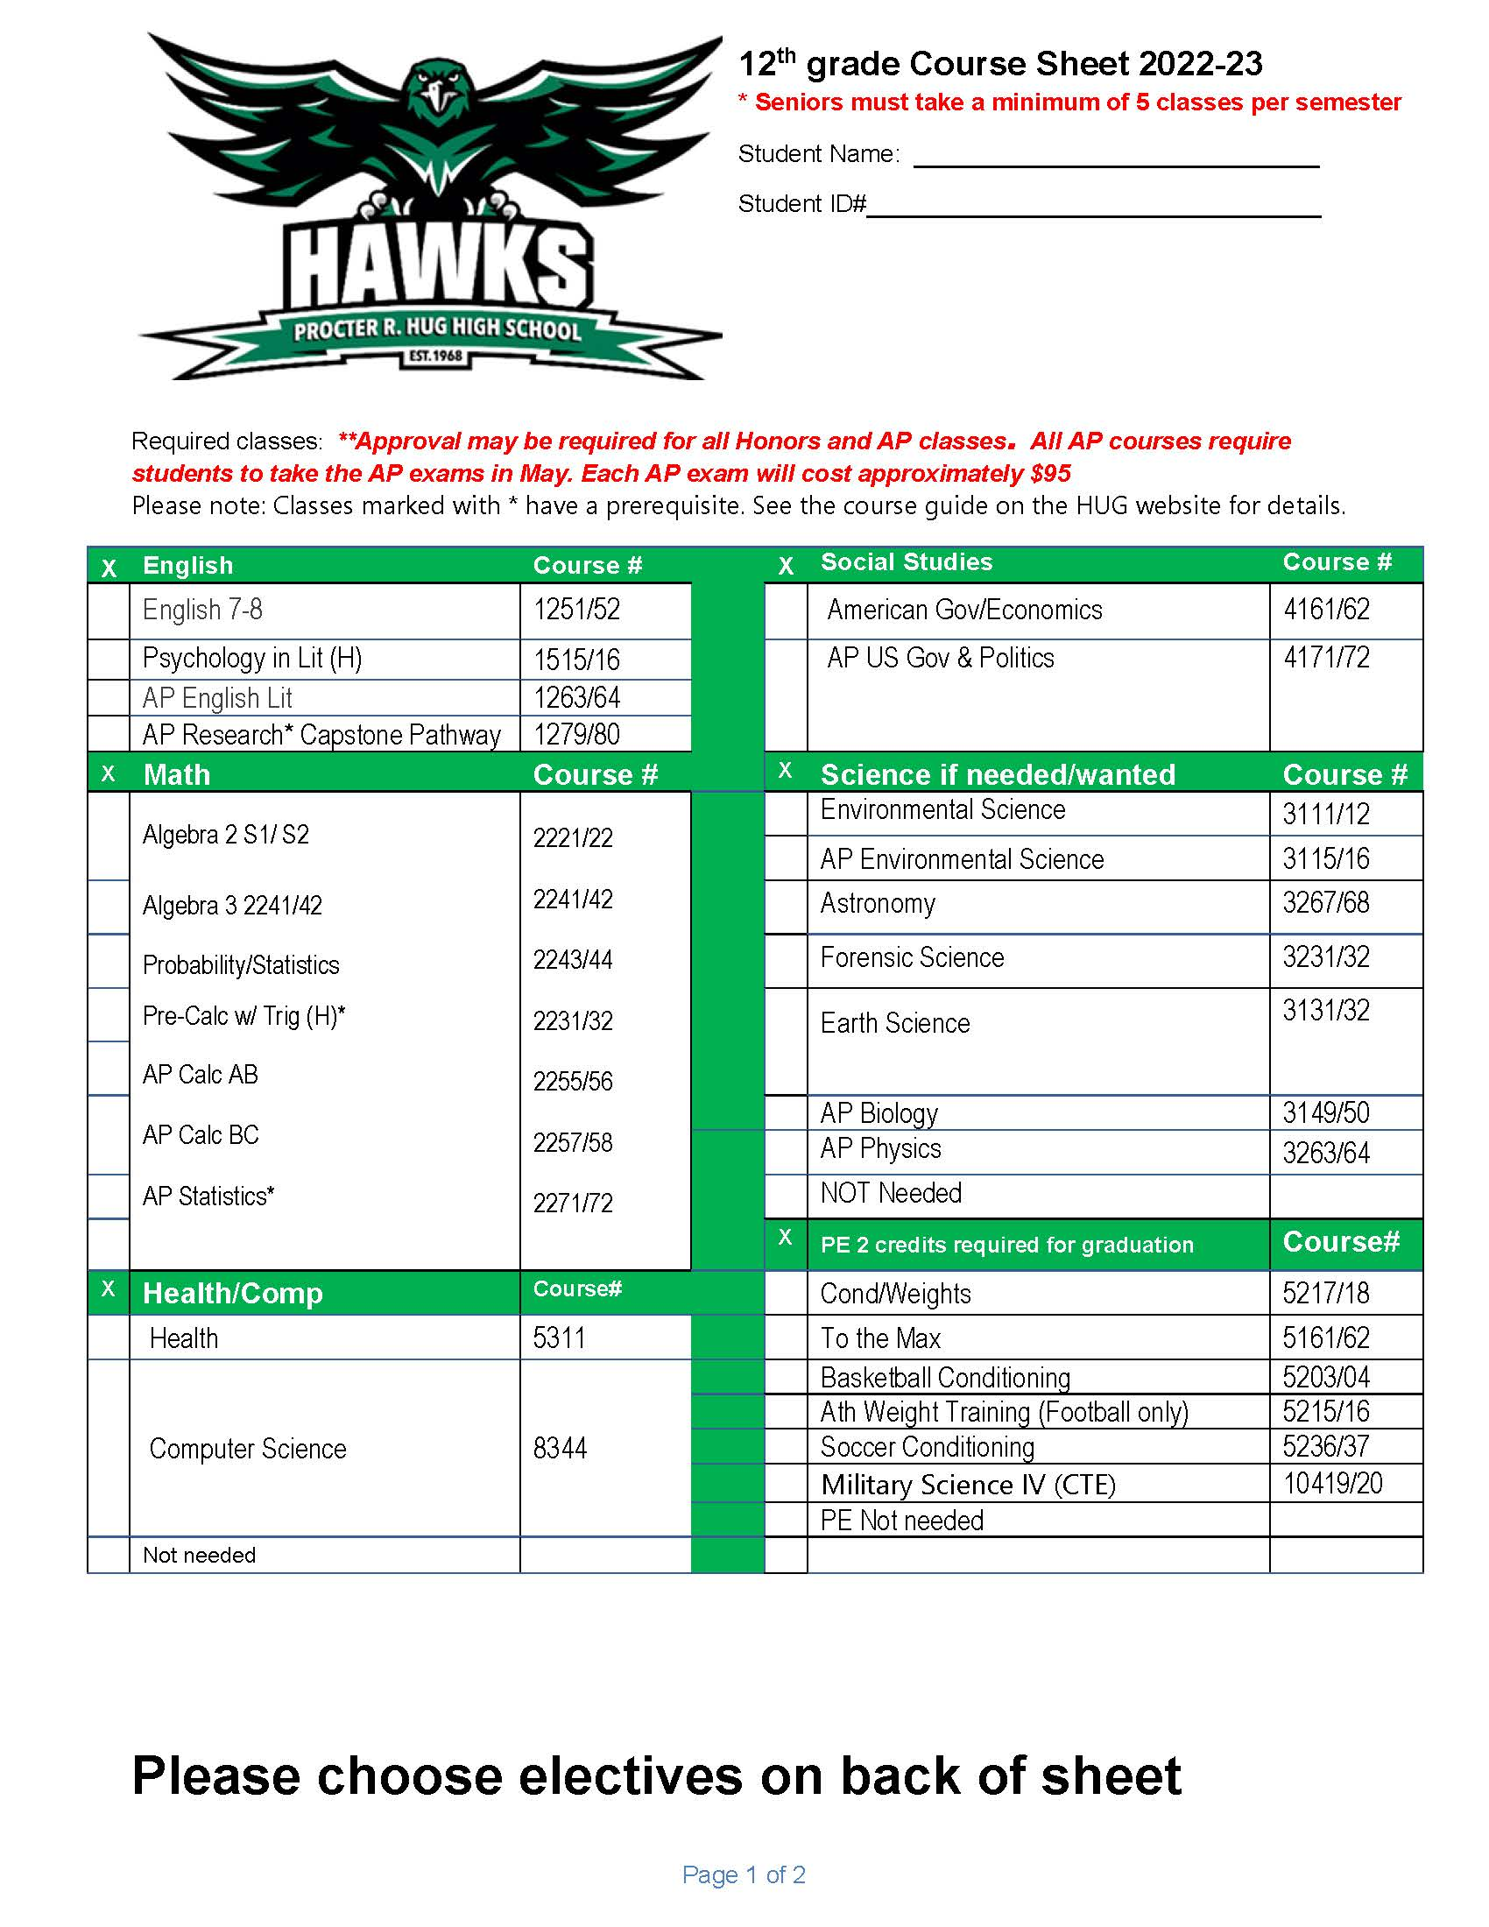
Planning your senior year: Grad Plan & Course Options
Use this grad plan along with your transcript to determine what courses you need for graduation utilizing the courses Hug has available.
You will meet with your counselor to pick classes.
Check out the course catalog on the website for course descriptions.

Slide 14
Other Course Options to keep in mind
Dual Credit College courses:
Links to TMCC and UNR Dual Enrollment information and list of approved dual credit courses available on wcsd.net. Next Jump Start webinar is March 18th
Work Experience
Need pay stubs with taxes taken out
Must work 180 hours to earn ½ credit
Internships
Reduced schedule: All seniors are required to take a full schedule (8 classes) unless they meet requirements for exemption.
On track as of fall semester 2025 to earn an Advanced Diploma (3.0 GPA)
Meet the requirements for exemption: Job, care for siblings etc.
Parent must sign the exemption form
You can discuss these options with your counselor during your Grad Plan/course selection meeting.
Off site group internships available on the WCSD website

Slide 15
Course Selections
If you have a job and want off campus, you will need to submit a current pay stub and an Exemption form ASAP.
You will be meeting with your counselor to do course selection.
If you do not complete course selection with your counselor, we will have to choose your classes for you.
Schedule changes in the fall will NOT be approved for any other reason other than for meeting graduation requirements. Choose wisely and choose for the full year.

Slide 16
School Counselor Info
All counselor emails and the appointment request form can be found on the Hug Counseling website.
https://www.washoeschools.net/hugcounseling
Please visit the Junior Page on the Hug counseling website for important information and links

Slide 17
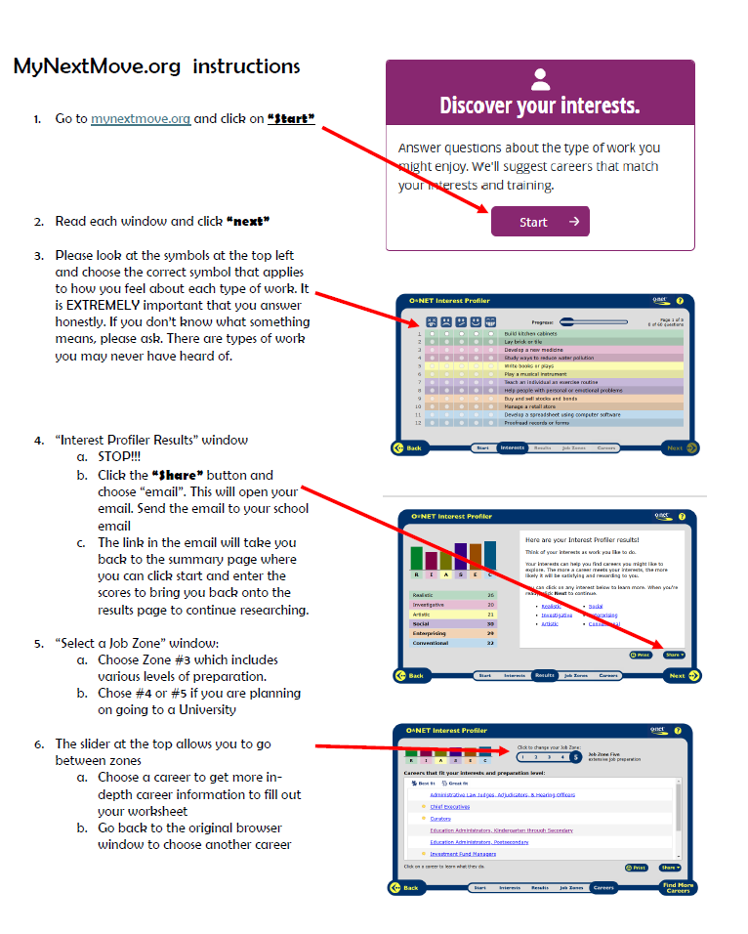
Career Interest Lesson: Mynextmove.org
Please go to mynextmove.org
Follow these instructions along with the counselor prompts
Complete Worksheet

Slide 18
EXIT TICKET
On the Junior page of the Hug Counseling website, please complete the Post-Survey
Your counselors look forward to meeting with you to review your Grad Plans and do course selection for your Senior Year!
DON’T FORGET – The ACT is on February 25th.
It is required for graduation.
It is truly an important test!! Get ready!!

Slide 19

COLLEGE TRIVIA (if time allows)
In small groups, answer the trivia questions on the cards.
One person can read the question, and the others will answer it.

